Slide 1


Likelihood of
Obesity Diseases

Slide 2
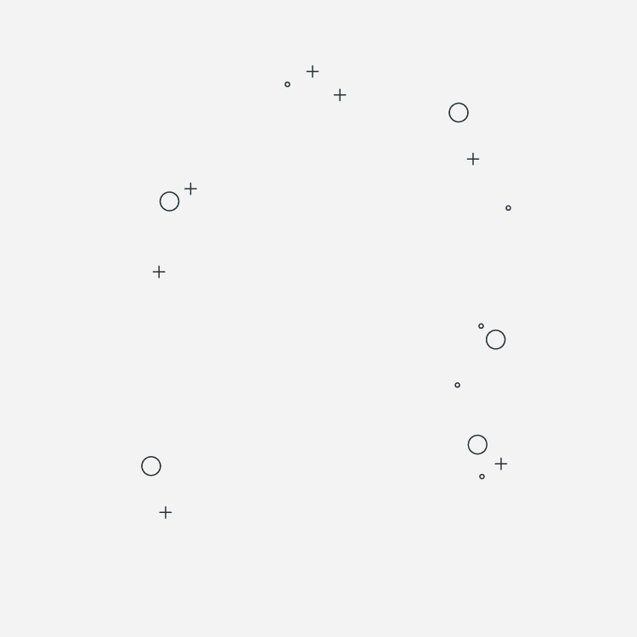
01. Project Overview
04. APP Design
02. DATA Mining
05. FUTURE WORK
03. CLASSIFIERS
01

Slide 3

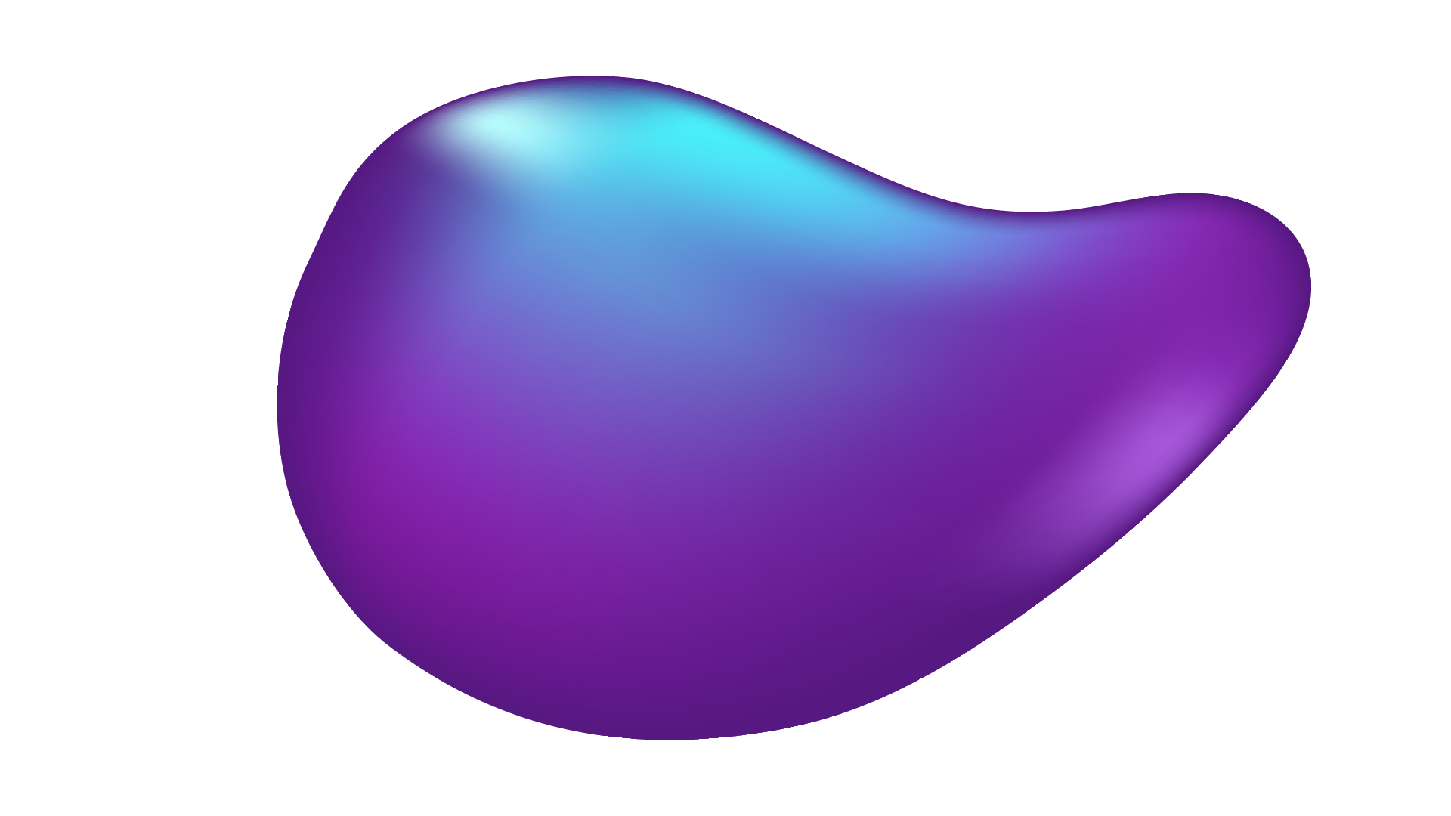
01
Project Overview

Slide 4
Obesity
1
2
3
AI model
Mobile app

Slide 5
Obesity
2
1
3
AI model
Mobile app

Slide 6
Obesity
3
2
1
AI model
Mobile app

Slide 7
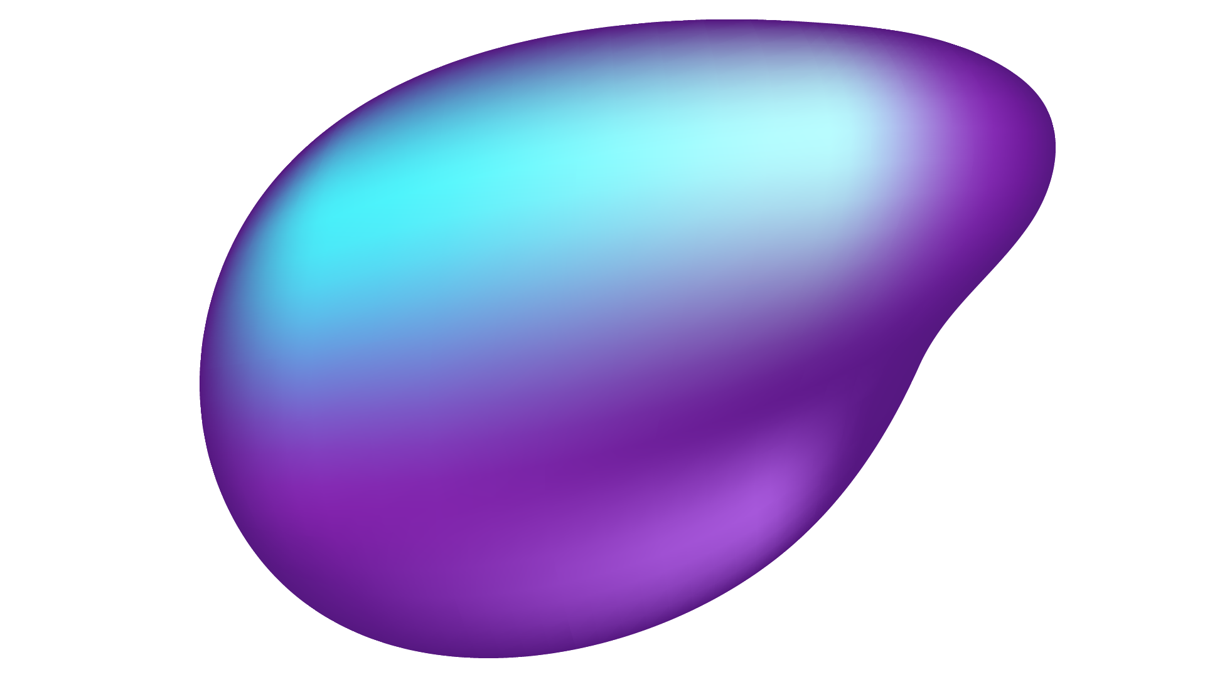
02
DATA
EXPLORATION & CLEANING

Slide 8
What normal calculators do ?
01 Basic Data
02 Lifestyle Data
All online calculators get the recommended number of calories based on the Basic Data ONLY of the user and the result will be the same for all users who have the same basic information regardless their lifestyle of their daily activity

Slide 9
What make us differnet ?
01 Basic Data
02 Lifestyle Data
In our model, we take Basic Data as well as the user’s lifestyle and his/her daily exercise and another personal parameters which effect on the decision of our model (the recommended number of daily calories to reach to the target weight)

Slide 10
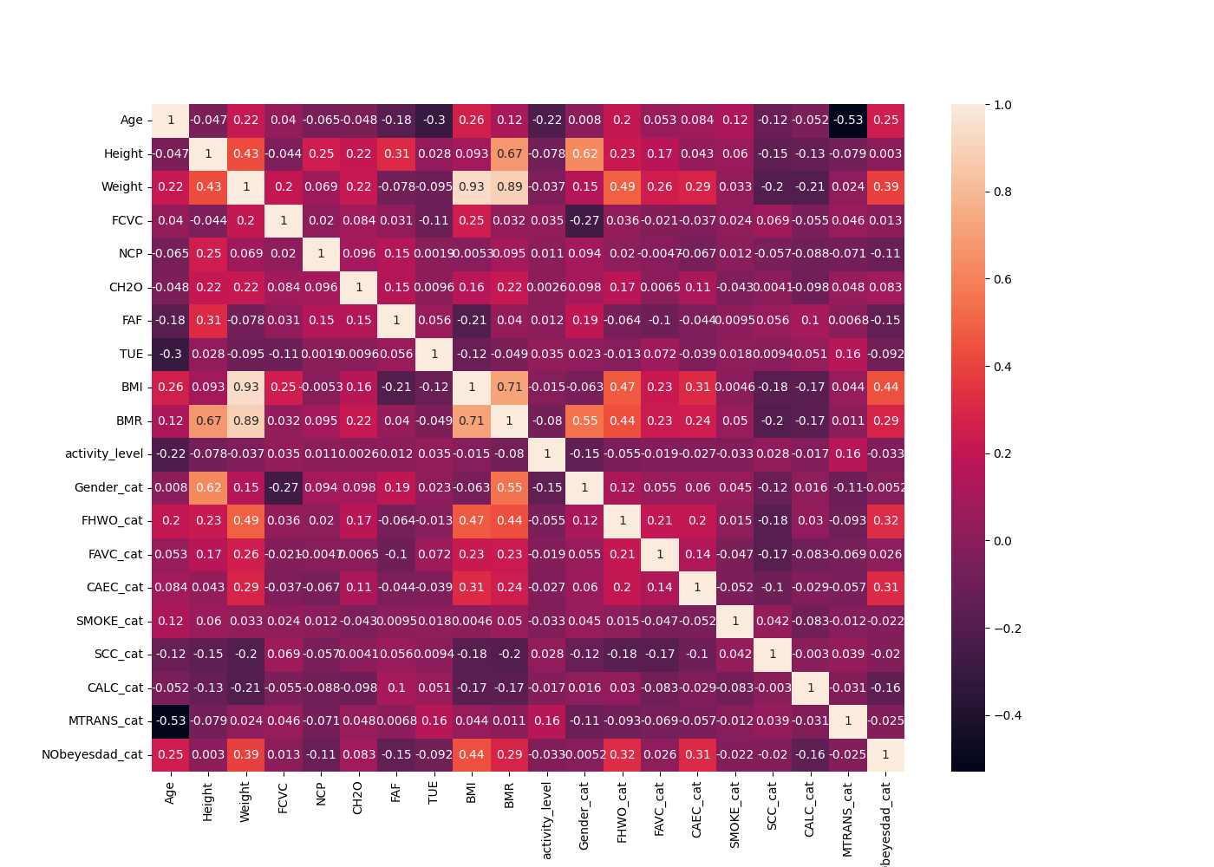
II- Correlation between features
Identifying Relationships
Predictive Power
Feature Selection
Multivariate Relationships
03

Slide 11
03
Our Model
Algorithm

Slide 12
MODEL GOALS
GOAL 1
Predict Obesity type.
GOAL 2
Determine how far the actual weight is from the ideal weight.
GOAL 3
Recommend Meals & Exercises & Weeks needed to be there.

Slide 13
MODEL INPUTS
Basic Data
Additional Data
Health Condition
Supplementary Data
Activity Level
Family History with Obesity
Smoking Status
Alcohol
Calories tracking.
Physical Activity .
Technological Devices usage.
Usual transportation method.
Gender
Weight
Age
Height
High caloric food.
Vegetables- containing meals.
Main meals.
Any snacks between meals.
Water amount.

Slide 14

Model Accuracy
99 %

Slide 15
OUTPUTS
MODEL OUTPUT
WEIGHT COMPARISON
MEALS & EXERCISES
Obesity type according to the provided model inputs
Compare current weight with ideal weight to see if adjustments needed.
Modify the food plan based on the these adjustments.

Slide 16
How can the USER get benefit from our project ?
04

Slide 17
04
App Design

Slide 18

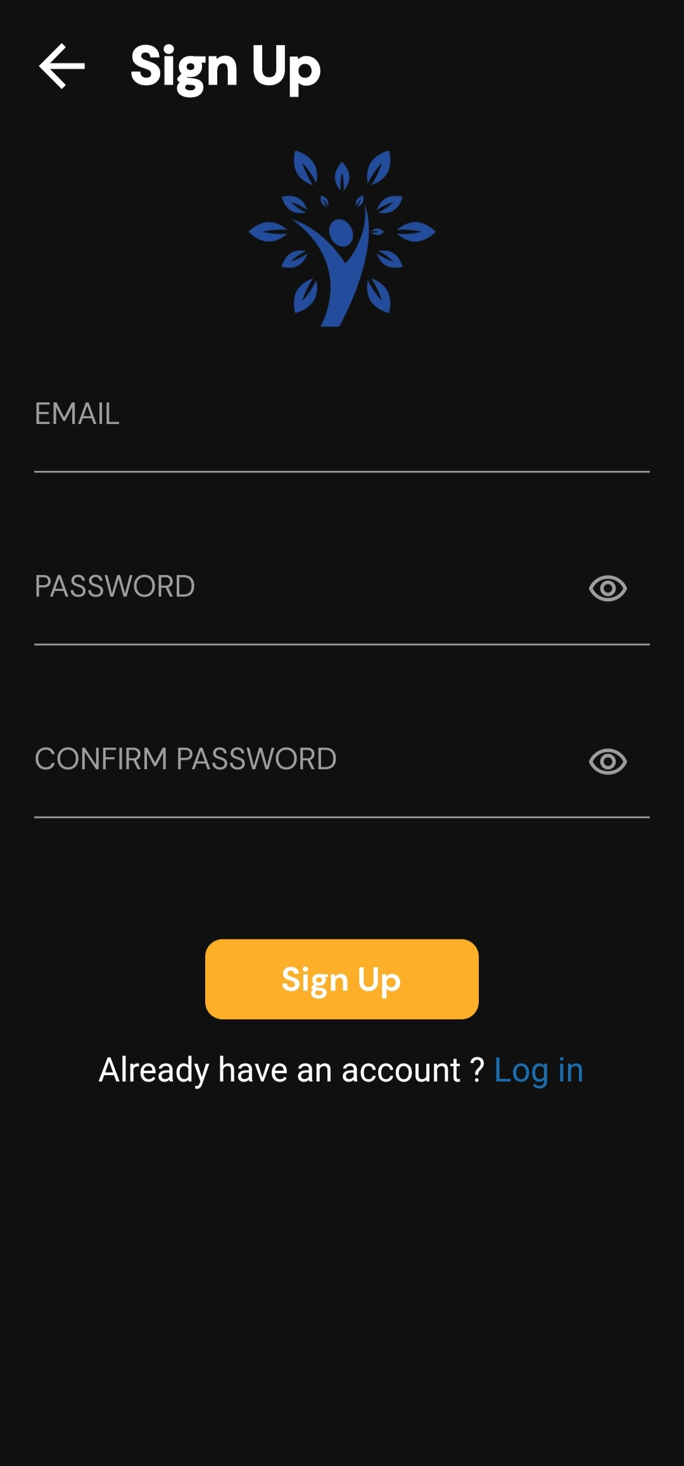
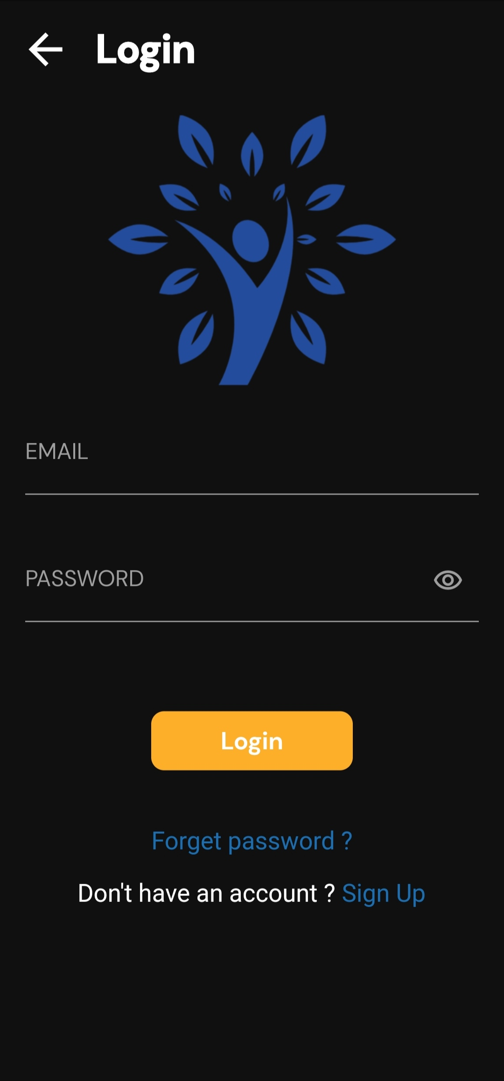
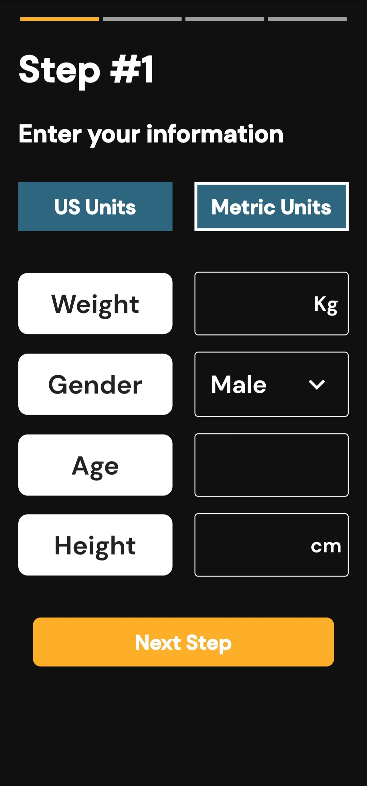
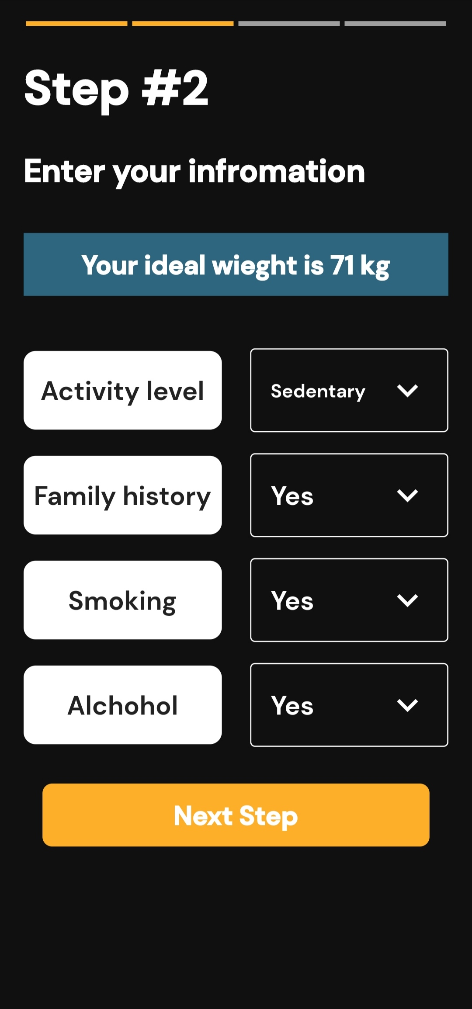
UI design

Slide 19
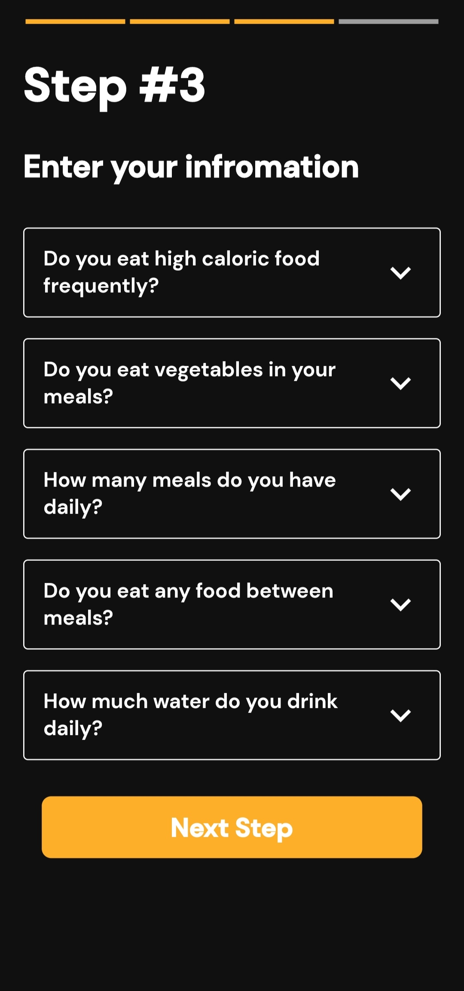
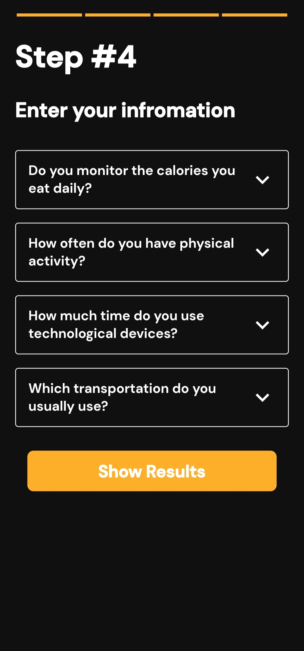
UI design

Slide 20
UI design

Slide 21
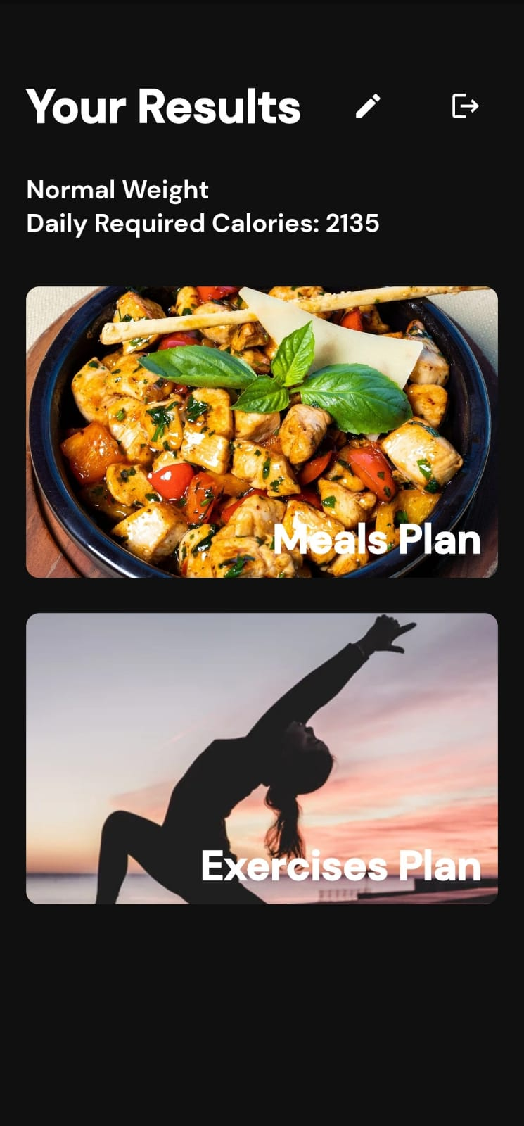
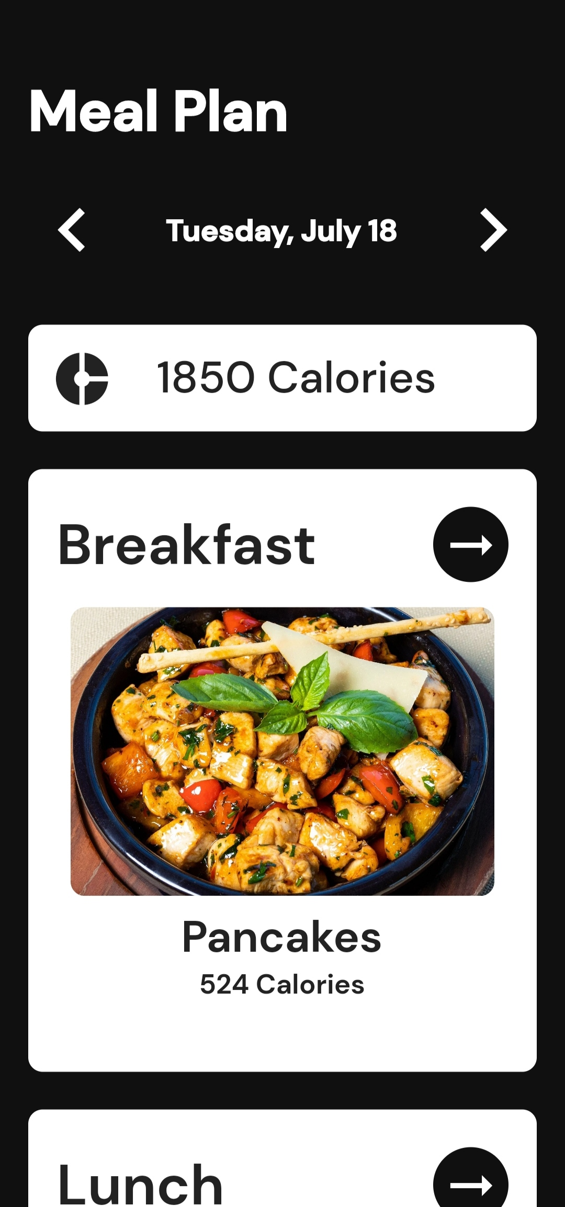
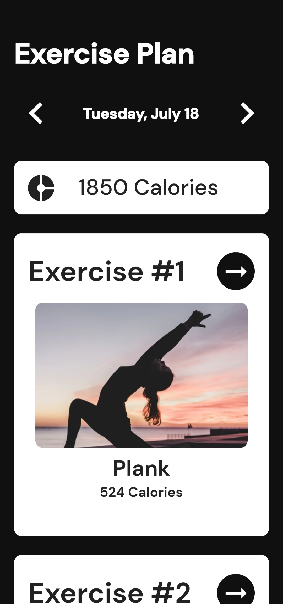
UI design

Slide 22
UI design

Slide 23
05
FUTURE WORK

Slide 24
OUR ASPIRATIONS
1
Collect the user’s Medical History to Improve his/her Experience
2
Partnership with Nutritionists

Slide 25
The Power of
EMR

Slide 26
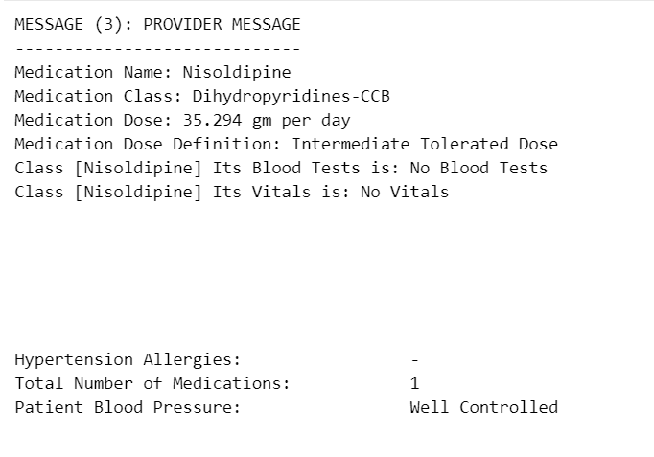

Slide 27
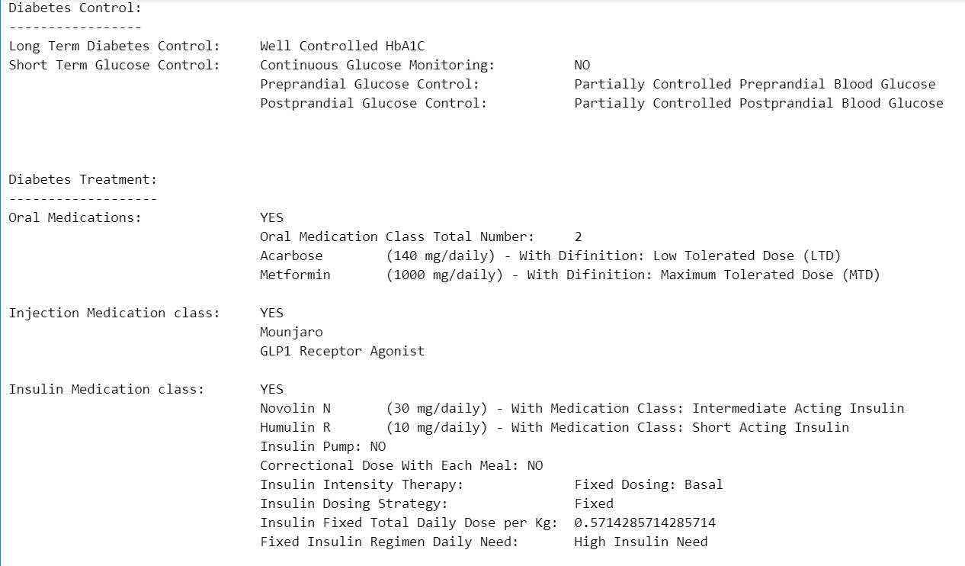

Slide 28
Obesity in
EGYPT !!!

Slide 29

“Prevalence of Obesity According to "100 million health" survey ,which was conducted in Egypt in 2019 and screened 49.7 million adult Egyptians ( ≥ 18 years old ), 39.8% of adult Egyptians suffered from obesity (BMI ≥ 3030 kg/m²). Obesity was more prevalent in adult females than adult males (49.5% of Egyptian adult females suffered obesity compared to 29.5% for males)”.

Slide 30

“A study published in the New England Journal of medicine pointed out that 19 million Egyptians are obese, accounting for 35% of the adult population, the highest”

Slide 31
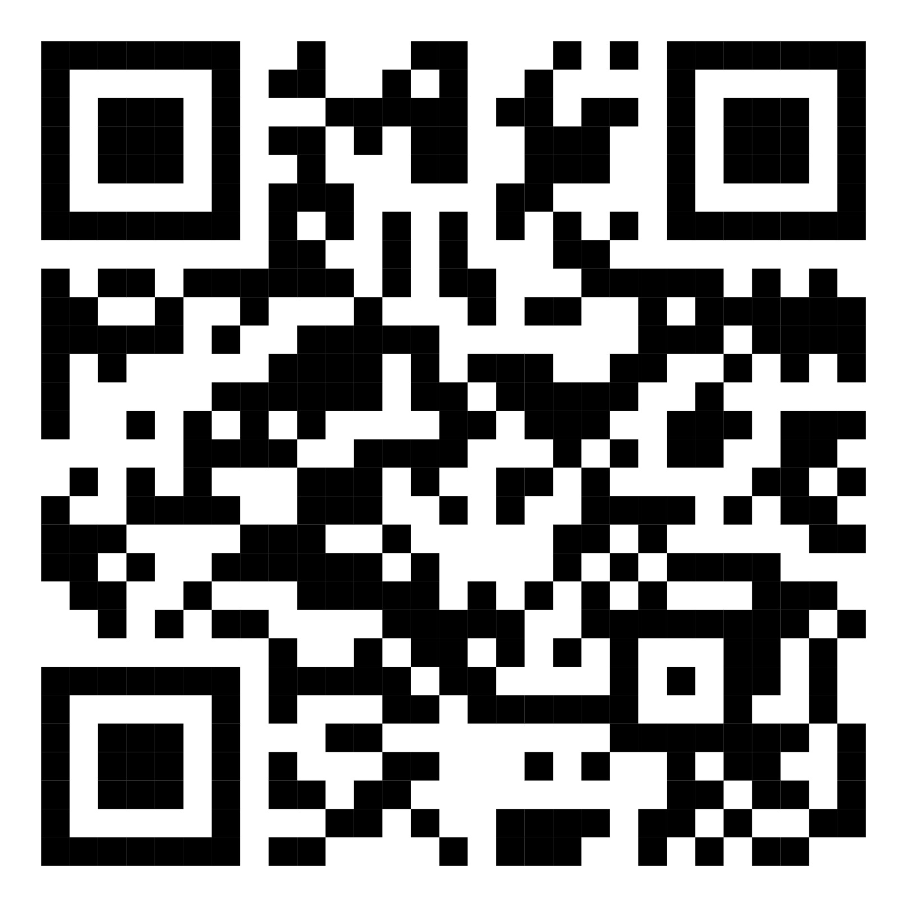
THANKS
Do you have any questions ?

